Slide 1

Training React 30-11-2018

Slide 2
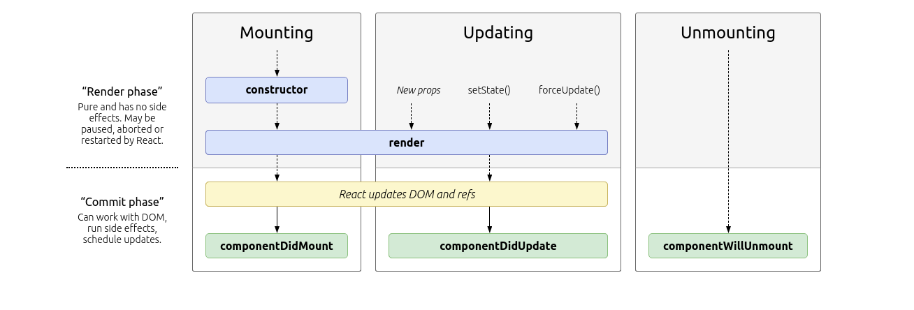
Lifecycle methods
React
1

Slide 3
Fetch API
Replaces XMLHttpRequest
Promise which returns the json
Browser function:
Framework independent
{
headers: {…},
method: “...”,
body: …
}
stream
React
1

Slide 4


Proptypes
Used for typesafety in the props of a component
https://github.com/facebook/prop-types
React
1

Slide 5
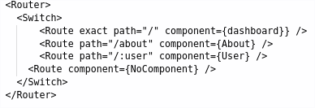
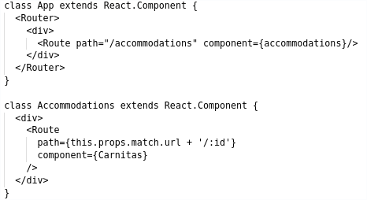
Router
Package ‘react-router-dom’
<Router> … </Router> sets up the router
<Switch> ... </Switch> takes care of exclusivity
<Route /> binds a path to a component
Declarative routing!
Add extra routes wherever you want!
React
1

Slide 6
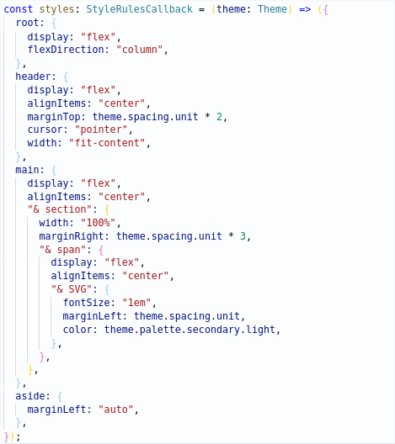
JSS
Styled components
Easy use of variables
No automatic inheritance
Scoped: no side effects!
React
1

Slide 7

Hands-on Time!
Questions?
React
1

Slide 8
Hands-on: Getting started
Git clone https://github.com/AMIS-Services/react-series
Cd into dir sig2/exercise/koa, run:
`yarn install`
`yarn start-db`
`yarn start`
`yarn seed-db`
Visit localhost:3030/accommodations to verify back-end is working
Cd into dir sig2/exercise/react, run `yarn install` and `yarn start`
Visit localhost:3000 to verify front-end is working
For examples of ES6 syntax, view the file slides/syntax.js
React
1

Slide 9
Hands-on: Fetching data
Create a file `src/common/fetch.js`
Create a fetch function which can be called to handle requests to the back-end using `window.fetch()`.
Use this function to fetch the accommodations in the lifecyclemethod `componentDidMount()` in `Accommodations.js`. Be aware this is an asynchronous process, so return `null` in the render method until the accommodations have been loaded!
Have a change in the ‘favorite’ state persisted in the back-end by using `{method: ‘PUT’, ... }` as an option. Note: do not pass the id or timestamps and be sure to set the content type!
Bonus: Add error handling for response errors to your fetch function
Bonus: Add error handling for network errors to your fetch function
React
1

Slide 10
Hands-on: PropTypes
Add PropTypes from the package prop-types to the AppBar and AccommodationCard components
Use `PropTypes.shape({...})` to describe an object
Give a prop a wrong PropType and open the terminal to see what happens
React
1

Slide 11
Hands-on: Routing
Create a component which will be shown on 404
Create a component for an accommodations detail page. For now just render ‘hello world’.
Add `<Router>...</Router>` from the package react-router-dom to your App.js
Import createHistory function from history/createBrowserHistory and pass it in the history prop of the router element
Add a Switch component
Add a `<Route …/>` for path `”/”` to your accommodations component
Add a route for path `”/:id”` to your accommodation detail component
Add a route for path `”*”` to your 404 component
Visit localhost:3000/[accommodation id] and see if your detail page renders. Why not?
React
1

Slide 12
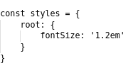

Hands-on: JSS styling
Add a styles object to every styled component:
Provide the styles to your component in its props:
Attach the classes to their corresponding elements:
React
1

Slide 13
Hands-on: Fetching and routing part deux
Add an onClick function to your AccommodationCard component which implements `this.props.history.push(...)`. This function is provided when you use `export default withRouter(AccommodationCard). WithRouter comes from the package ‘react-router-dom’.
Edit your accommodation detail component to use `export default withRouter(AccommodationDetail)`.
Console.log `this.props` to see where your ID is
Use the ID in the lifecycle method `componentDidMount` to fetch the detailed information for the accommodation.
Add the information and some styling to the components render function. Don’t forget that fetch is an async action!
React
<number>

